Slide 1



Intention and
Motor Representation
in Joint Action
s.butterfill@warwick.ac.uk
Intention and Motor Representation in Joint Action
s.butterfill@warwick.ac.uk & corrado.sinigaglia@unimi.it
Notes:
Which events are joint actions? Nearly all philosophers and quite a few psychologists have assumed that this question can be fully answered by appeal to a special kind of intention, often called shared intention. According to them, for an event to be a joint action is for it to stand in an appropriate relation to a shared intention.

Slide 2
‘I take a collective action to involve a collective [shared] intention.’
(Gilbert 2006, p. 5)
‘The sine qua non of collaborative action is a joint goal [shared intention] and a joint commitment’
(Tomasello 2008, p. 181)
‘the key property of joint action lies in its internal component [...] in the participants’ having a “collective” or “shared” intention.’
(Alonso 2009, pp. 444-5)
‘Shared intentionality is the foundation upon which joint action is built.’
(Carpenter 2009, p. 381)

Slide 3
‘I take a collective action to involve a collective [shared] intention.’
(Gilbert 2006, p. 5)
‘The sine qua non of collaborative action is a joint goal [shared intention] and a joint commitment’
(Tomasello 2008, p. 181)
‘the key property of joint action lies in its internal component [...] in the participants’ having a “collective” or “shared” intention.’
(Alonso 2009, pp. 444-5)
‘Shared intentionality is the foundation upon which joint action is built.’
(Carpenter 2009, p. 381)
Notes:
To focus on just one case, Alonso says ‘the key property of joint action lies in its internal component [...] in the participants’ having a “collective” or “shared” intention.’
(Alonso 2009, pp. 444-5)
In the terminology of this workshop, joint action is explicated entirely in terms of reflective states, in terms of propositional attitudes like intentions and knowledge and processes like explicit practical reasoning.
Philosophers and psychologists who hold this view may allow that pre-reflective states and processes sometimes play a role in enabling joint action; but they do not think that pre-reflective states or processes are needed for understand what joint action is.

Slide 4
‘I take a collective action to involve a collective [shared] intention.’
(Gilbert 2006, p. 5)
‘The sine qua non of collaborative action is a joint goal [shared intention] and a joint commitment’
(Tomasello 2008, p. 181)
‘the key property of joint action lies in its internal component [...] in the participants’ having a “collective” or “shared” intention.’
(Alonso 2009, pp. 444-5)
‘Shared intentionality is the foundation upon which joint action is built.’
(Carpenter 2009, p. 381)
Notes:
I want to argue that this is a mistake.
Fully explicating joint action involves appeal to both pre-reflective and reflective structures, structures of motor representation as well as to structures of intention.

Slide 5
‘I take a collective action to involve a collective [shared] intention.’
(Gilbert 2006, p. 5)
‘The sine qua non of collaborative action is a joint goal [shared intention] and a joint commitment’
(Tomasello 2008, p. 181)
‘the key property of joint action lies in its internal component [...] in the participants’ having a “collective” or “shared” intention.’
(Alonso 2009, pp. 444-5)
‘Shared intentionality is the foundation upon which joint action is built.’
(Carpenter 2009, p. 381)
Notes:
I hope it’s obvious why this might interest philosophers; but it is not immediately obvious why scientists should care.
After all, if your questions are about how joint actions is possible in practice, why do you need to care about what exactly joint action is?
I think the view I’ll offer is might just be relevant, in a small way, to scientists as well.
Scientists, both those working on both action generally and those working on joint action in particular, sometimes tend to ignore reflective states and processes.
Perhaps because it’s very hard to get any handle on the reflective stuff, which seems to float free of any bodily or motor constraints.
My suggestion is this: identifying a role for pre-reflective motor representations and processes in explaining what joint action may eventually enable us to understand how reflective states and processes--structures of intention and knowledge and the practical reasoning in which these feature---are anchored in the pre-reflective.
So the central claim is going to be that you can’t fully explain what joint action is by appeal to reflective states and processes only; structures of motor representation are also relevant.

Slide 6
premise:
Reciprocal agent-neutral motor representation enables some joint actions
Notes:
I’m going to start from a premise which is rightly controversial: reciprocal agent-neutral motor representation enables joint action

Slide 7
premise:
Reciprocal agent-neutral motor representation enables some joint actions
Notes:
A motor representation is \emph{agent-neutral} if it concerns an action which is not one’s one or, in the case of joint action, not entirely one’s own.

Slide 8
premise:
Reciprocal agent-neutral motor representation enables some joint actions
Notes:
Two or more motor representations are \emph{reciprocal} just if there is a single outcome which each motor representation represents.

Slide 9
premise:
Reciprocal agent-neutral motor representation enables some joint actions
Notes:
Sometimes I’ll using the term \emph{social} motor representation for reciprocal agent-neutral motor representations.
I have a slightly bad conscience about this because I’m not sure they’re actually social in any ordinary sense.
It is almost uncontroversial that agent-neutral motor representations exist, and I see no reason to doubt that they could be reciprocal.
The controversial part of the premise is the claim that such representations can enable joint action.
Why think the premise is true? I’m not going to argue for it, but I do want to mention one study that seems to be relevant to the premise.

Slide 10

premise:
Reciprocal agent-neutral motor representation enables some joint actions
“Simulation of another person’s action, as reﬂected in the activation of motor cortices, gets stronger the more the other is perceived as an interaction partner.”
--- Kourtis, Sebanz & Knoblich (2010, p. 4)

Slide 11
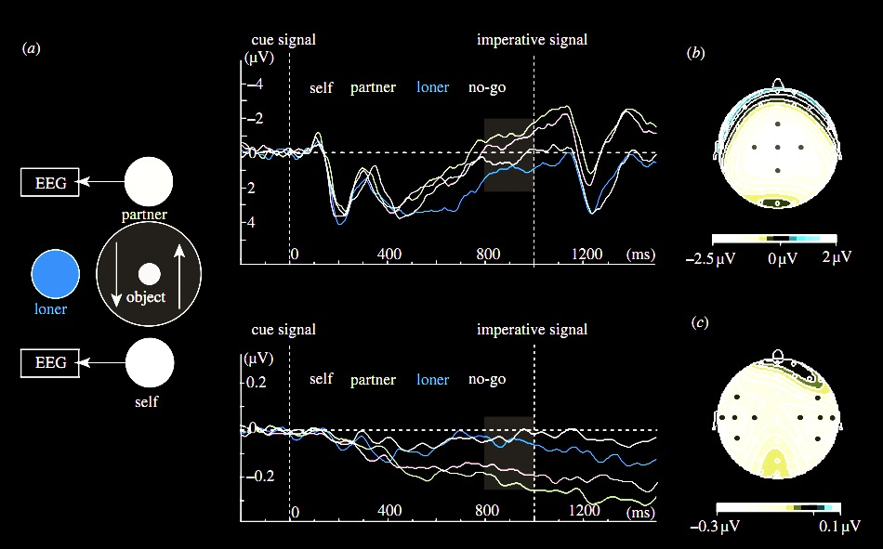
premise:
Reciprocal agent-neutral motor representation enables some joint actions
Kourtis, Sebanz & Knoblich (2010)
Notes:
Here’s the experiment they did.
The task was simple: two people sat opposite each other. Sometimes they acted alone, picking up and replacing an object. And sometimes had to act together, passing an object between them. Also present was the ‘loner’ who always acted alone.

Slide 12
premise:
Reciprocal agent-neutral motor representation enables some joint actions
Kourtis, Sebanz & Knoblich (2010)
Notes:
EEG measurements of motor activation were recorded.

Slide 13
premise:
Reciprocal agent-neutral motor representation enables some joint actions
Kourtis, Sebanz & Knoblich (2010)

Slide 14
premise:
Reciprocal agent-neutral motor representation enables some joint actions
Kourtis, Sebanz & Knoblich (2010)
Notes:
The researchers found that patterns of activation for self & joint action partner were similar, and different from patterns of activation for the actions of the loner which were similar to patterns in a ‘no go’ condition where no one was to act.

Slide 15
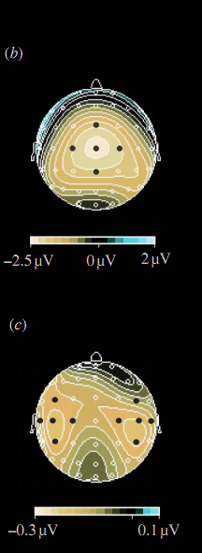
premise:
Reciprocal agent-neutral motor representation enables some joint actions
Kourtis, Sebanz & Knoblich (2010)
Notes:
So here’s what I take from this paper.
If you are engaged in a joint action with someone, one which involves moving an object by passing it between you, then each of you has motor representations of the other’s actions and these motor representations are functionally equivalent to motor representations of your own actions in the sense that they are just the sorts of representation that might have caused you to do what the other is doing (if you were in her position).

Slide 16
premise:
Reciprocal agent-neutral motor representation enables some joint actions
Kourtis, Sebanz & Knoblich (2010)
Notes:
Suppose that Kourtis et al are right that social motor representation is more likely to occur in joint action than when one is merely observing.
And suppose we take a leap and conjecture that social motor representation enables joint action
We need to ask ...

Slide 17
How could reciprocal agent-neutral motor representation ever enable any joint action?
Notes:
How could reciprocal agent-neutral motor representation ever enable any joint action?

Slide 18
Move it from there to here
Notes:
Let’s step back and consider an individual action.
An agent moves a mug from one place to another, passing in from her left hand to her right hand half way [*demonstrate].
It’s a familiar idea that motor representations for planning and monitoring action involve an hierarchical structure,
where there is a relatively abstract representation of an outcome that is progressively filled in.

Slide 19
Move it from there to here
get it
move it
position it
hand-1
reach
grasp
move
arrive
release
hand-2
reach
grasp
move
place
release
Notes:
So motor planning involves starting with relatively abstract representations of outcomes and filling in details ...

Slide 20
Move it from there to here
get it
move it
position it
hand-1
reach
grasp
move
arrive
release
hand-2
reach
grasp
move
place
release
Notes:
And there is a need, even for a single agent, to synchronize actions in time and space; in this case because there’s an exchange between the two hands.
How is this relevant to the case of joint action?

Slide 21
joint action: same goal
Move it from there to here
get it
move it
position it
hand-1
reach
grasp
move
arrive
release
hand-2
reach
grasp
move
place
release
Notes:
In joint action the agents have the same goal, to move the object from there to here.

Slide 22
joint action: same goal
Move it from there to here
get it
move it
position it
hand-1
reach
grasp
move
arrive
release
hand-2
reach
grasp
move
place
release
similar timing problem
Notes:
They also face a similar coordination problem, requiring a precisely timed swap

Slide 23
joint action: same goal
Move it from there to here
get it
move it
position it
same planning
hand-1
reach
grasp
move
arrive
release
hand-2
reach
grasp
move
place
release
similar timing problem
Notes:
And Koutis et al’s findings (and others’ findings) suggest that the same planning in involved in the joint action case, almost up to the actual muscle contractions.
That is, in the joint action situation each agent plans both agents’ actions as if they were the actions of a single agent.
This may be what enables them to coordinate so well : each is able to plan her own actions in a way that meshes with the other agent’s actions because each agent is planning (and monitoring) both their actions almost as if a single agent were going to execute the whole action.
And of course this is exactly what we want for small-scale joint action---we want two or more agents to act as one.

Slide 24
joint action: same goal
Move it from there to here
get it
move it
position it
same planning
hand-1
reach
grasp
move
arrive
release
hand-2
reach
grasp
move
place
release
inhibition needed
similar timing problem
Notes:
So what is the difference between the individual and the joint case? From the point of view of motor representation, the primary difference may be that in joint action there is a need to inhibit execution of the parts of the action which are not one’s own.
Here then is the basic idea I take to be guiding Kourtis and others.
The idea is that coordination is sometimes achieved by having each agent’s motor system plan all of their actions;
given some assumptions, this could be a way of making it likely that each will execute their part in the joint action in a way that meshes with the way the other agents execute their parts.

Slide 25
premise:
Reciprocal agent-neutral motor representation enables some joint actions
Notes:
Now so far I’ve only been considering a possible role for social motor representation in enabling joint action.
This leads to a question

Slide 26
premise:
Reciprocal agent-neutral motor representation enables some joint actions
question:
Does reciprocal agent-neutral motor representation also play a role in explaining what joint action is? [Yes]
challenge:
How could social motor representation and shared intention harmoniously contribute to joint action?
Notes:
The question is: Does social motor representation also play a role in explaining what joint is?
I think we the details already give us grounds for a positive answer, for holding that motor representation has a role to play in explaining what joint action is.
How does this work?
Let’s go back to individual action for a moment again.

Slide 27
What is the relation between a purposive action and the outcome or outcomes to which it is directed?
out
action
out
act
out
out
Notes:
A basic question about ordinary, individual action is:
What is the relation between a purposive action and the outcome or outcomes to which it is directed?
Many ordinary purposive actions have many different outcomes.
Grabbing little Isabel by the hands I swing her around, causing her to laugh and, simultaneously, breaking a vase.
In fact the outcome to which this purposive action was directed might not be among its actual outcomes; after all, actions can fail.

Slide 28
What is the relation between a purposive action and the outcome or outcomes to which it is directed?
out
action
out
out
act
out
out
Notes:
So among all the actual and possible outcomes of my action, one or some are singled out as specially related to this action.
One aspect of the question concerns what singles out the outcome or outcomes, actual or merely possible, to which a particular purposive is directed.
But there is also a second aspect ...

Slide 29
What is the relation between a purposive action and the outcome or outcomes to which it is directed?
wave
out
action
out
reach
act
out
grasp
out
scratch
Notes:
Ordinary purposive actions are sometimes composed of more than one motor action. My swinging Isabel around starts with my reaching for her wrists, grasping them and then spinning us around ... and my action doesn’t include other things which I might be doing simultaneously, like refusing a cup of tea with my eyes or trying to determine whether that smell is coming from Isabel’s sister Hannah’s nappy.

Slide 30
What is the relation between a purposive action and the outcome or outcomes to which it is directed?
wave
out
action
out
reach
act
out
grasp
out
scratch
Notes:
So another aspect of our question is what determines which activities comprise the purposive action and which do not.

Slide 31
What is the relation between a purposive action and the outcome or outcomes to which it is directed?
wave
out
action
out
reach
act
out
grasp
intention or motor representation
out
scratch
Notes:
The standard answer to this question involves intention.
An intention (1) represents an outcome, (2) coordinates the one or several activities which comprise the action; and (3) coordinate these activities in a way that would normally facilitate the outcome’s occurrence.
What binds particular component actions together into larger purposive actions? It is the fact that these actions are all parts of plans involving a single intention.
What singles out an actual or possible outcome as one to which the component actions are collectively directed? It is the fact that this outcome is represented by the intention.
So the intention is what binds component actions together into purposive actions and links the action taken as a whole to the outcomes to which they are directed.

Slide 32
What is the relation between a purposive action and the outcome or outcomes to which it is directed?
wave
out
action
out
reach
act
out
grasp
intention or motor representation
out
scratch
Notes:
Now as Elisabeth Pacherie has argued (and I’ve had a go at arguing this in joint work with Corrado Sinigaglia recently too),
motor representations are relevantly similar to intentions.
Of course motor representations differ from intentions in some important ways (as Pacherie also notes).
But they are similar in the respects that matter for explaining the purposiveness of action.
(1) Like intentions, some motor representations represent outcomes (and not merely patters of joint displacement, say).
(2) Like intentions, some motor representations play a role in coordinating multiple more component activities by virtue of their role as elements in hierarchically structured plans.
(3) And, like intentions, some motor representations coordinate these activities in a way that would normally facilitate the outcome’s occurrence.
So in the individual case, it seems to me quite straightforward that there is a role for motor representation to play in explaining the purposiveness of action [*explaining the possibility of purposive action?].
The claim is not that \emph{all} purposive actions are linked to outcomes by motor representations, just that some are.
In some cases, the purposiveness of an action is grounded in a motor representation of an outcome; in other cases it is grounded in an intention.
And of course in many cases it may be that both intention and motor representation are involved.

Slide 33
What is the relation between a purposive action and the outcome or outcomes to which it is directed?
wave
out
action
out
reach
act
out
grasp
intention or motor representation
out
scratch
Notes:
Now let’s turn to joint action.

Slide 34
joint
What is the relation between a purposive action and the outcome or outcomes to which it is directed?
wave
out
action
out
reach
act
out
grasp
intention or motor representation
out
scratch
Notes:
The same question we asked about ordinary, individual action also arises for joint action.
What is the relation between a purposive joint action and the outcome or outcomes to which it is directed?

Slide 35
joint
What is the relation between a purposive action and the outcome or outcomes to which it is directed?
out
joint
action
out
act
out
out
Notes:
And again the question has two aspects.
What singles out the outcome or outcomes to which a purposive joint action is directed?

Slide 36
joint
What is the relation between a purposive action and the outcome or outcomes to which it is directed?
wave
out
joint
action
out
reach
act
out
grasp
out
scratch
Notes:
And what binds together the various activities that make up the joint action?
The difference in the case of joint action is, of course, that these activities are not necessarily activities of a single agent.

Slide 37
joint
What is the relation between a purposive action and the outcome or outcomes to which it is directed?
wave
out
joint
action
out
reach
act
out
grasp
shared intention or social motor representation
out
scratch
Notes:
The answer to this question for the case of joint action is also superficially similar in the answer we gave in the case of ordinary, individual action.
A shared intention is what relates purposive joint actions to the outcomes to which they are directed.
For the shared intention
(1) involves a representation, on the part of each agent, of an outcome
(2) coordinates the several agents’ activities
and
(3) coordinates the several agents’ activities in such a that would normally facilitate the occurrence of the represented outcome.
It is in this sense that a shared intention can ground the purposiveness of a joint action.

Slide 38
joint
What is the relation between a purposive action and the outcome or outcomes to which it is directed?
wave
out
joint
action
out
reach
act
out
grasp
shared intention or social motor representation
out
scratch
Notes:
But what we saw earlier, what the research by Kourtis et al and others indicates, is that social motor representation can play a similar role to joint action.
Return to the example of a two agents moving an object in a way that involves passing it between them.
the motor representation
(1) involves a representation, on the part of each agent, of an outcome
In this case the outcome is the whole movement of the object
(2) coordinates the several agents’ activities
and
(3) coordinates the several agents’ activities in such a that would normally facilitate the occurrence of the represented outcome.
Because each agent represents the whole movement and plans all of its implementation irrespective of which parts she will actually perform, each agent plans the action in a way that should coordinate with the other agent’s plans providing they use similar planning procedures
[*What I’m saying here, in effect, is that both shared intention and social motor representation can yield a COLLECTIVE GOAL]

Slide 39
joint
What is the relation between a purposive action and the outcome or outcomes to which it is directed?
wave
out
joint
action
out
reach
act
out
grasp
shared intention or social motor representation
out
scratch
Notes:
What I’m suggesting is very simple.
If you think that in ordinary, individual action, the purposiveness of actions can be grounded by motor representations
(and you should think this because it’s true),
then you should also think the same about actions involving two or more agents---the purposiveness of a joint action can be grounded in motor representations as well as in shared intentions.

Slide 40

Sufficient conditions
We have a shared intention that we J if
“1. (a) I intend that we J and (b) you intend that we J
“2. I intend that we J in accordance with and because of la, lb, and meshing subplans of la and lb; you intend [likewise] …
“3. 1 and 2 are common knowledge between us”
(Bratman 1993: View 4)
Notes:
Let me try another way of presenting the same idea.
Here are Michael Bratman’s sufficient conditions for shared intention.
I want to suggest that social motor representation provides a parallel

Slide 41
Sufficient conditions
We have a shared intention that we J if
“1. (a) I intend that we J and (b) you intend that we J
“2. I intend that we J in accordance with and because of la, lb, and meshing subplans of la and lb; you intend [likewise] …
“3. 1 and 2 are common knowledge between us”
(Bratman 1993: View 4)
Notes:
There is a direct parallel with the first condition: in the case of motor representation, each agent represents the outcome (e.g. the movement of the object).
The key claim here is that some motor representations (i) represent outcomes, and (ii) represent the outcomes of actions not all of whose components will be executed by the agent whose motor representation it is.

Slide 42
Sufficient conditions
We have a shared intention that we J if
“1. (a) I intend that we J and (b) you intend that we J
“2. I intend that we J in accordance with and because of la, lb, and meshing subplans of la and lb; you intend [likewise] …
“3. 1 and 2 are common knowledge between us”
(Bratman 1993: View 4)
Notes:
Here there is clearly no \emph{direct} parallel.
I don’t think motor representations can represent motor representations in the way that intentions can represent intentions.
But I do think there is a parallel of sorts.
Each agent’s having a motor representation of the distributed goal of their action does ensure meshing of subplans.
What ensures this meshing is not the fact that each agent represents the others’ plans.
Rather in the case where joint actions is grounded in social motor representation, what ensures meshing of subplans is two facts (i) each agent plans all of the agents’ actions, and (ii) the agents rely on similar planning strategies (planning strategies that are sufficiently similar to ensure meshing subplans).

Slide 43
Sufficient conditions
We have a shared intention that we J if
“1. (a) I intend that we J and (b) you intend that we J
“2. I intend that we J in accordance with and because of la, lb, and meshing subplans of la and lb; you intend [likewise] …
“3. 1 and 2 are common knowledge between us”
(Bratman 1993: View 4)
Notes:
I’m less sure about a parallel to the common knowledge condition.
As I see things, the justification for supposing that shared intention involves common knowledge concerns a normative link between intention and reasons.
In acting on intentions, one should be acting for reasons.
And a consideration can only be among your reasons if you know that consideration.
So I think the need for common knowledge arises from the need to explain how another person’s intentions could be among your reasons for acting.
I don’t think this need arises in the case of motor representation because it seems to me that the sort of planning of which motor representation is an element does not involve acting for reasons in the same sense.
(In motor action, there are reasons why we do things (of course!) but these are not reasons for which we act.)
What motor joint action requires is not that your motor plans provide reasons for mine.
There just has to be a good chance that this is true relative to the costs and benefits of joint action and the alternatives to joint action.
So I think that instead of common *knowledge*, in the case of social motor representation there is a common *background* of dispositions, habits and expectations.
[***CUT but one thing that might do the work of common knowledge is a custom or habit
that would allow the agents, in their particular social context, to rely on each other’s cooperation.
In some countries this sort of thing works on public transport;
it is reasonable to take for granted that, if you are obviously struggling with a pram or suitcase, then someone nearby will help.]

Slide 44
Sufficient conditions
We have a shared intention that we J if
“1. (a) I intend that we J and (b) you intend that we J
“2. I intend that we J in accordance with and because of la, lb, and meshing subplans of la and lb; you intend [likewise] …
“3. 1 and 2 are common knowledge between us”
(Bratman 1993: View 4)
Notes:
If this is right, if social motor representations play a role analogous to the structure of intentions and knowledge which Bratman identifies as sufficient for shared intention, then this is another reason to think that motor representations can ground the purposiveness of joint action.

Slide 45
premise:
Reciprocal agent-neutral motor representation enables some joint actions
question:
Does reciprocal agent-neutral motor representation also play a role in explaining what joint action is? [Yes]
challenge:
How could social motor representation and shared intention harmoniously contribute to joint action?
Notes:
Recap: the question was: Does social motor representation also play a role in explaining what joint is?
I have just been arguing for a positive answer.
My thesis is this:
\textbf{
Reciprocal agent-neutral motor representations coordinate multiple agents’ actions by virtue of representing an outcome to which each agent’s actions are directed.
}
That is, reciprocal social motor representations can ground the purposiveness of joint action.
This is why I think that fully understanding what joint action is requires understanding the coordinating role of social motor representation and not only understand shared intention.

Slide 46
premise:
Reciprocal agent-neutral motor representation enables some joint actions
question:
Does reciprocal agent-neutral motor representation also play a role in explaining what joint action is? [Yes]
challenge:
How could social motor representation and shared intention harmoniously contribute to joint action?
?
reciprocal agent-neutral motor representation
= shared intention?
Notes:
But at this point you might say that social motor representation doesn’t really add anything new to our understanding of joint action.
Rather, you might object, social motor representation is just a variety of shared intention.
So I’m wrong to think that there is a *distinctive* role for social motor representation to play in explaining the possibility of purposive joint action.
All I’ve done is shown that what philosophers call shared intention can be realised by structures of what scientists call motor representations.

Slide 47
premise:
Reciprocal agent-neutral motor representation enables some joint actions
question:
Does reciprocal agent-neutral motor representation also play a role in explaining what joint action is? [Yes]
challenge:
How could social motor representation and shared intention harmoniously contribute to joint action?
?
reciprocal agent-neutral motor representation
= shared intention?
‘the key property of joint action lies in its internal component [...] in the participants’ having a “collective” or “shared” intention.’
(Alonso 2009, pp. 444-5)
Notes:
And this of course would mean that there is no conflict between the standard view that we can fully explain what joint action is just in terms of shared intention.
But I don’t think this is right.
To see why, we have to step back to intention generally and ask ....

Slide 48
What are intentions for?
Notes:
So what are intentions for?
I’m going to assume that intention is something over and above basic beliefs and desires; that an intention is not, for instance, merely a strongest desire.
There is a temptation to assume that intention is involved in every case of purposive action.
But it’s hard to see what the argument for this could be.
In many cases it seems that beliefs, desires and motor representations are all that is needed to explain purposive action.
You offer me a biscuit. I want one, and I believe I can get one by reaching out for it. So I do reach for it. As far as I can see, there’s no need to suppose that, in addition to the belief and desire, it must be the case that I also intend to take a biscuit.
(At least not unless we take ‘intention’ to mean ‘strongest desire’, which it does not.)
Maybe I do intend this.
But it’s possible for an agent to take and eat a biscuit, and to do so purposively, without having any intentions at all.
Beliefs desires and motor representations are sufficient.
So (again), what are intentions for?

Slide 49
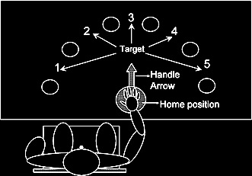
(Zhang and Rosenbaum 2007)
Notes:
Motor representations are involved in this kind of planning ...
[Motor representations enable quite sophisticated planning over short periods of time and sequences of action; for example, how you grasp a pointer will depend on what you are about to do with it \citep{zhang:2007_planning}.
This sort of planning does not need intentions at all. So what are intentions for?

Slide 50
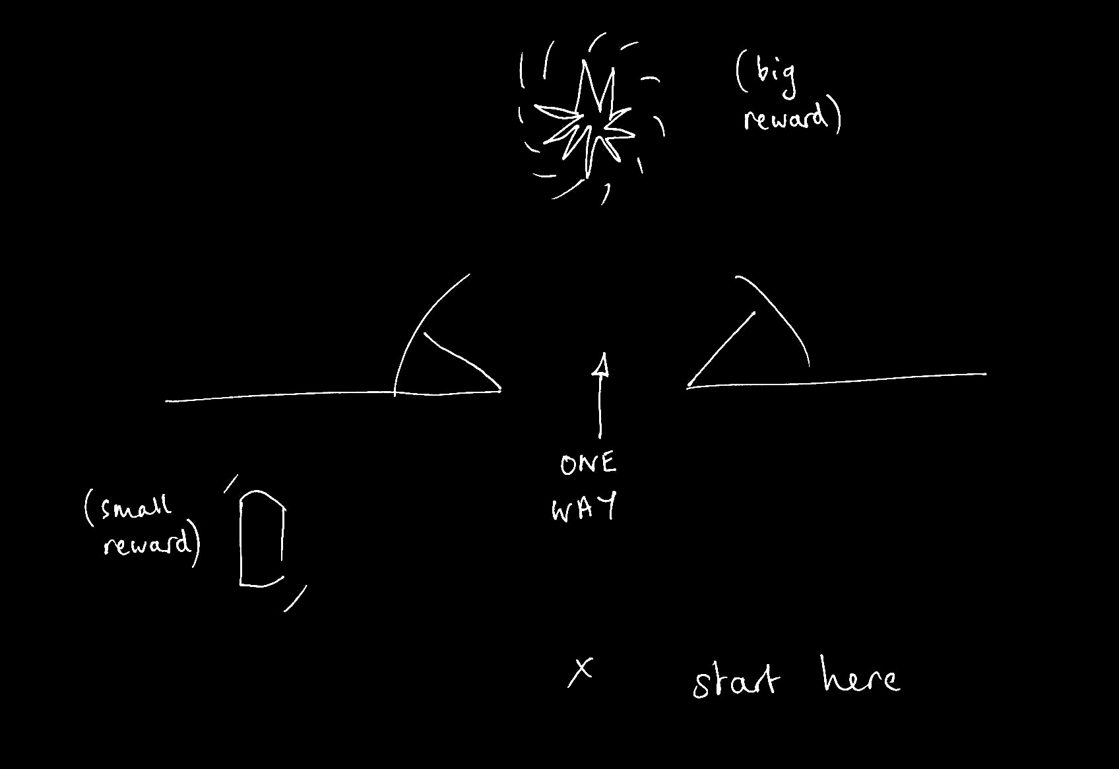
Notes:
Intentions are involved in this kind of planning ...
\emph{Intentions are for planning multiple separate actions over longer periods of time; and for planning multiple separate actions whose execution is mutually constraining where the outcomes cannot be represented motorically.}
This is a case where intentions are really needed --- can’t act on strongest desire (for the big reward) if want to maximise rewards by collecting the small and the large reward.
And can’t rely on motor representation because the motor system doesn’t care about things that cannot be represented in motor terms.
Not all purposive actions involve any planning of this sort.
Now you could imagine a two-person version of this task where we are rewarded for what we collectively achieve. In this case it’s optimal if one of us goes for the small reward and the other goes for the large reward. I think it’s this kind of planning that shared intention is really for.

Slide 51
shared
What are intentions for?
Notes:
So what are intentions for?
I’m going to assume that intention is something over and above basic beliefs and desires; that an intention is not, for instance, merely a strongest desire.
There is a temptation to assume that intention is involved in every case of purposive action.
But it’s hard to see what the argument for this could be.
In many cases it seems that beliefs, desires and motor representations are all that is needed to explain purposive action.
You offer me a biscuit. I want one, and I believe I can get one by reaching out for it. So I do reach for it. As far as I can see, there’s no need to suppose that, in addition to the belief and desire, it must be the case that I also intend to take a biscuit.
(At least not unless we take ‘intention’ to mean ‘strongest desire’, which it does not.)
Maybe I do intend this.
But it’s possible for an agent to take and eat a biscuit, and to do so purposively, without having any intentions at all.
Beliefs desires and motor representations are sufficient.
So (again), what are intentions for?

Slide 52
Notes:
\emph{Intentions are for planning multiple separate actions over longer periods of time; and for planning multiple separate actions whose execution is mutually constraining where the outcomes cannot be represented motorically.}
This is a case where intentions are really needed --- can’t act on strongest desire (for the big reward) if want to maximise rewards by collecting the small and the large reward.
And can’t rely on motor representation because the motor system doesn’t care about things that cannot be represented in motor terms.
Not all purposive actions involve any planning of this sort.
Now you could imagine a two-person version of this task where we are rewarded for what we collectively achieve. In this case it’s optimal if one of us goes for the small reward and the other goes for the large reward. I think it’s this kind of planning that shared intention is really for.

Slide 53
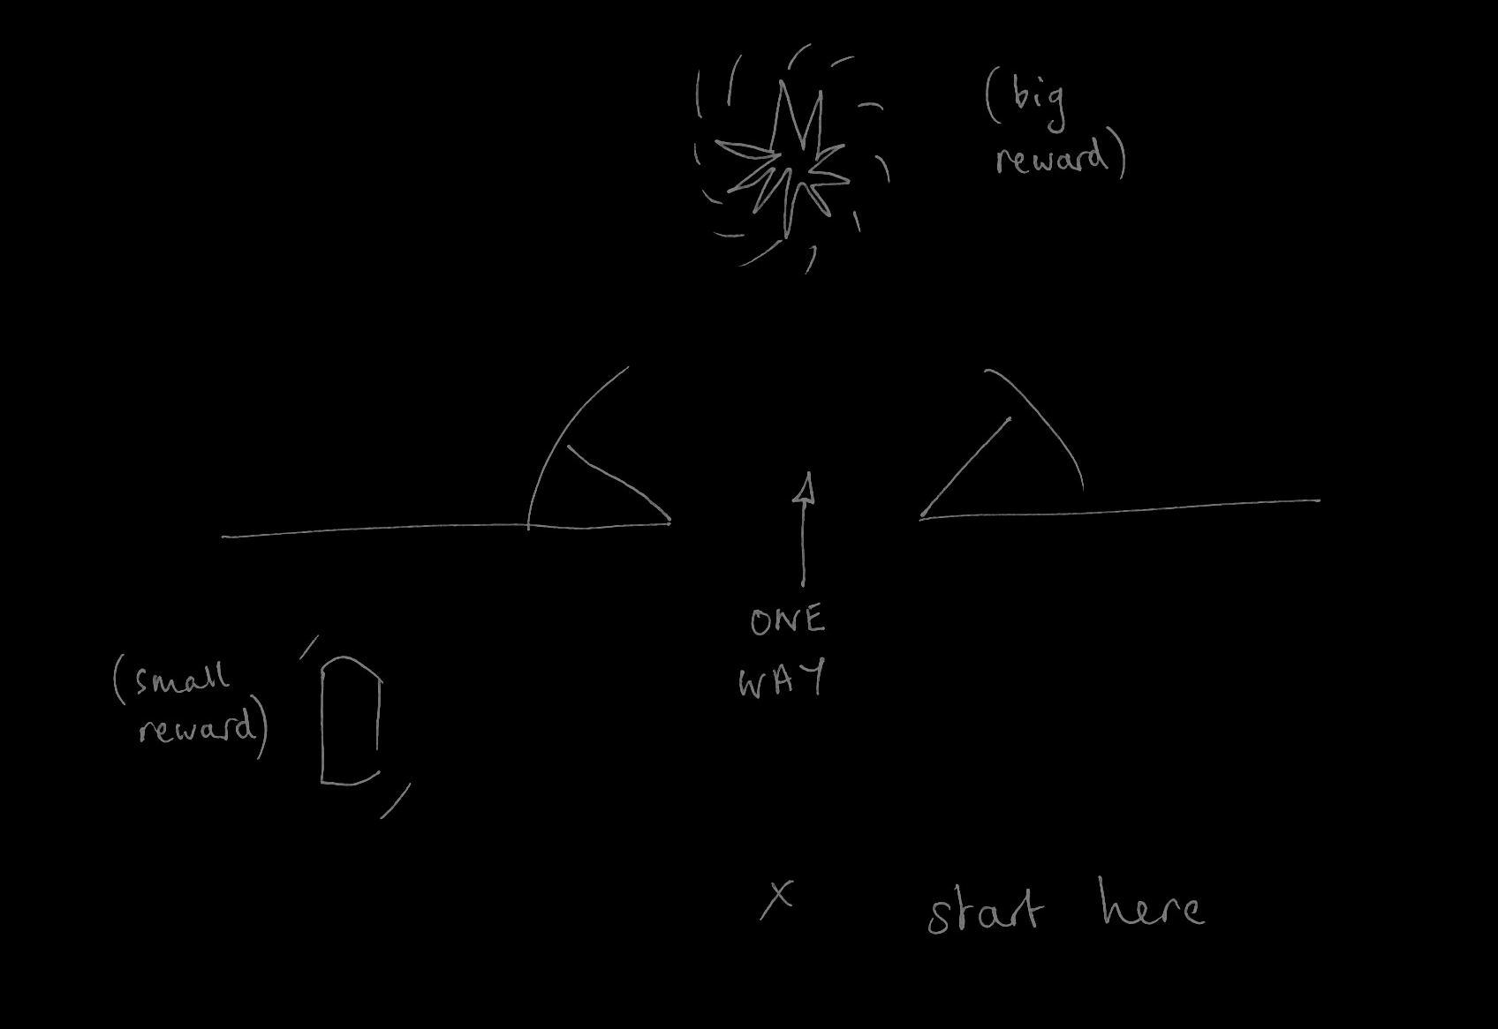
moving an object together
(Kourtis et al 2010)
tidying up the toys together
(Behne et al 2005)
cooperatively pulling handles in sequence to make a dog-puppet sing
(Brownell et al 2006)
bouncing a cube on a large trampoline together
(Tomasello & Carpenter 2007)
pretending to row a boat together
Notes:
By contrast, in many ordinary cases of joint action there is no need for planning of this sort and so no need for shared intention. Actions such as these \emph{might} involve shared intention but they do not \emph{necessarily} involve shared intention. Coordination is taken care of by motor processes, or by the structure of the environment, or by the fact that we have physically coupled our bodies (in rowing a boat).
I’m suggesting that some joint actions---like the one two people move an object in a way that involves passing it between them---don’t require this kind of planning and so don’t necessarily involve shared intentions.
In some cases, social motor representation alone is sufficient for purposive joint action.

Slide 54
premise:
Reciprocal agent-neutral motor representation enables some joint actions
question:
Does reciprocal agent-neutral motor representation also play a role in explaining what joint action is? [Yes]
challenge:
How could social motor representation and shared intention harmoniously contribute to joint action?
?
reciprocal agent-neutral motor representation
= shared intention?
‘the key property of joint action lies in its internal component [...] in the participants’ having a “collective” or “shared” intention.’
(Alonso 2009, pp. 444-5)
Notes:
So the question was whether social motor representation is merely a variety of shared intention.
One reason for resisting this conclusion is that the two seem to have quite different functions.
Another is that they differ in representational format.
Let me go slowly here because the notion of format is crucial for the final point I want to make.

Slide 55
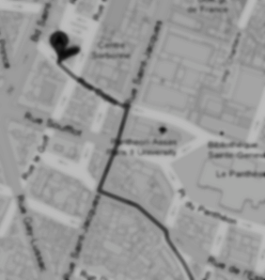

< different content >
Notes:
As background we first need a generic distinction between content and format. Imagine you are in an unfamiliar city and are trying to get to the central station. A stranger offers you two routes. Each route could be represented by a distinct line on a paper map. The difference between the two lines is a difference in content. Each of the routes could alternatively have been represented by a distinct series of instructions written on the same piece of paper; these cartographic and propositional representations differ in format. The format of a representation constrains its possible contents. For example, a representation with a cartographic format cannot represent what is represented by sentences such as `There could not be a mountain whose summit is inaccessible.'\footnote{ Note that the distinction between content and format is orthogonal to issues about representational medium. The maps in our illustration may be paper map or electronic maps, and the instructions may be spoken, signed or written. This difference is one of medium.} The distinction between content and format is necessary because, as our illustration shows, each can be varied independently of the other.

Slide 56
< different content >
Head southeast on Rue Cujas toward Rue Victor Cousin. Turn right onto Rue Saint-Jacques. ...
Take RER B and get out at the Luxembourg station, from there it's less than 5 minutes walk.
< different format >
Notes:
As background we first need a generic distinction between content and format. Imagine you are in an unfamiliar city and are trying to get to the central station. A stranger offers you two routes. Each route could be represented by a distinct line on a paper map. The difference between the two lines is a difference in content. Each of the routes could alternatively have been represented by a distinct series of instructions written on the same piece of paper; these cartographic and propositional representations differ in format. The format of a representation constrains its possible contents. For example, a representation with a cartographic format cannot represent what is represented by sentences such as `There could not be a mountain whose summit is inaccessible.'\footnote{ Note that the distinction between content and format is orthogonal to issues about representational medium. The maps in our illustration may be paper map or electronic maps, and the instructions may be spoken, signed or written. This difference is one of medium.} The distinction between content and format is necessary because, as our illustration shows, each can be varied independently of the other.

Slide 57
Head southeast on Rue Cujas toward Rue Victor Cousin. Turn right onto Rue Saint-Jacques. ...
=
?
Notes:
Format matters because only where two representations have the same format can they be straightforwardly inferentially integrated.
To illustrate, let’s stay with representations of routes.
Suppose you are given some verbal instructions describing a route. You are then shown a representation of a route on a map and asked whether this is the same route that was verbally described. You are not allowed to find out by following the routes or by imagining following them.
Special cases aside, answering the question will involve a process of translation because two distinct representational formats are involved, propositional and cartographic. It is not be enough that you could follow either representation of the route. You will also need to be able to translate from at least one representational format into at least one other format.

Slide 58
Only representations with a common format can be inferentially integrated.
Any two intentions can be inferentially integrated in practical reasoning.
My intention that I visit Paris on Friday is a propositional attitude.
Notes:
This brings me to the argument ...

Slide 59
Only representations with a common format can be inferentially integrated.
Any two intentions can be inferentially integrated in practical reasoning.
My intention that I visit Paris on Friday is a propositional attitude.
All intentions are propositional attitudes.

Slide 60
Only representations with a common format can be inferentially integrated.
Any two intentions can be inferentially integrated in practical reasoning.
My intention that I visit Paris on Friday is a propositional attitude.
All intentions are propositional attitudes.
No motor representations are propositional attitudes.
Notes:
This brings me to the argument ...

Slide 61
Only representations with a common format can be inferentially integrated.
Any two intentions can be inferentially integrated in practical reasoning.
My intention that I visit Paris on Friday is a propositional attitude.
All intentions are propositional attitudes.
No motor representations are propositional attitudes.
No motor representations are intentions
Notes:
This brings me to the argument ...

Slide 62
Only representations with a common format can be inferentially integrated.
Any two intentions can be inferentially integrated in practical reasoning.
My intention that I visit Paris on Friday is a propositional attitude.
All intentions are propositional attitudes.
No motor representations are propositional attitudes.
No motor representations are intentions
Notes:
This step is questionable. I don’t have an argument for this and I’m not sure it isn’t terminological.
What I care about is that we distinguish attitudes according to the processes in which they feature.
So if you like we could distinguish two kinds of intention, one propositional the other motor.
As long as we distinguish representations of different formats I don’t see that it matters too much whether we call them all intentions or whether we use that term for only some of them.
[*intention in narrow sense and intention in the broad sense (cf desire); in the broad sense, desires can be intentions and so can instructions.]

Slide 63
Only representations with a common format can be inferentially integrated.
Any two intentions can be inferentially integrated in practical reasoning.
My intention that I visit Paris on Friday is a propositional attitude.
All intentions are propositional attitudes.
No motor representations are propositional attitudes.
No motor representations are intentions
Notes:
So where does this leave us?
The question was whether reciprocal agent-neutral motor intentions could count as shared intentions.

Slide 64
premise:
Reciprocal agent-neutral motor representation enables some joint actions
question:
Does reciprocal agent-neutral motor representation also play a role in explaining what joint action is? [Yes]
challenge:
How could social motor representation and shared intention harmoniously contribute to joint action?
?
reciprocal agent-neutral motor representation
= shared intention?
Notes:
So the question was whether social motor representation is just a variety of motor representation.
And the answer is no because these two differ with respect to both function and representational format.
It’s only in an extremely abstract sense that they can be regarded as varieties of a single type of state.
Social motor representations has a distinctive role in explaining the purposiveness of joint actions, one that is quite different from the role played by shared intention.
This means, I think that we have to treat the notion of joint action as heterogeneous, just as the notion of action is.
Recognizing the distinctive roles of shared intention and social motor representation leads to a problem, which I’ll call the interface problem ...

Slide 65
The Interface Problem:

Slide 66
The Interface Problem:
Some joint actions involve both shared intention and reciprocal agent-neutral motor representation

Slide 67
The Interface Problem:
Reciprocal agent-neutral motor representations:
i. represent outcomes;
ii. ground the purposiveness of some
joint actions
Some joint actions involve both shared intention and reciprocal agent-neutral motor representation

Slide 68
The Interface Problem:
Reciprocal agent-neutral motor representations:
i. represent outcomes;
ii. ground the purposiveness of some
joint actions
Two outcomes, A and B, match in a particular context just if, in that context, either the occurrence of A would normally constitute or cause, at least partially, the occurrence of B or vice versa.
Some joint actions involve both shared intention and reciprocal agent-neutral motor representation

Slide 69
The Interface Problem:
How are non-accidental matches possible?
Reciprocal agent-neutral motor representations:
i. represent outcomes;
ii. ground the purposiveness of some
joint actions
Two outcomes, A and B, match in a particular context just if, in that context, either the occurrence of A would normally constitute or cause, at least partially, the occurrence of B or vice versa.
Some joint actions involve both shared intention and reciprocal agent-neutral motor representation

Slide 70
The Interface Problem:
How are non-accidental matches possible?
Reciprocal agent-neutral motor representations:
i. represent outcomes;
ii. ground the purposiveness of some
joint actions; and
iii. differ in format from (the constituent attitudes of) shared intentions.
Two outcomes, A and B, match in a particular context just if, in that context, either the occurrence of A would normally constitute or cause, at least partially, the occurrence of B or vice versa.
Some joint actions involve both shared intention and reciprocal agent-neutral motor representation

Slide 71
The Interface Problem:
How are non-accidental matches possible?
Reciprocal agent-neutral motor representations:
i. represent outcomes;
ii. ground the purposiveness of some
joint actions; and
iii. differ in format from (the constituent attitudes of) shared intentions.
Two outcomes, A and B, match in a particular context just if, in that context, either the occurrence of A would normally constitute or cause, at least partially, the occurrence of B or vice versa.
Some joint actions involve both shared intention and reciprocal agent-neutral motor representation
Notes:
interface problem arises in the individual case as well as the joint case, of course ...

Slide 72
The Interface Problem:
How are non-accidental matches possible?
Reciprocal agent-neutral motor representations:
i. represent outcomes;
ii. ground the purposiveness of some
joint actions; and
iii. differ in format from (the constituent attitudes of) shared intentions.
Two outcomes, A and B, match in a particular context just if, in that context, either the occurrence of A would normally constitute or cause, at least partially, the occurrence of B or vice versa.
Some joint actions involve both shared intention and reciprocal agent-neutral motor representation
Notes:
Think first about how we might solve it in the individual case

Slide 73
Head southeast on Rue Cujas toward Rue Victor Cousin. Turn right onto Rue Saint-Jacques. ...
=
?
Notes:
There is a way to make the problem of comparison between representational formats trivial

Slide 74
Follow that route
=
?
Notes:
Suppose one representation involves a demonstrative that refers by deferring to another representation

Slide 75
Follow that route
=
?
Notes:
Then the comparison doesn’t require translation between formats after all.
Maybe the same can be true for intentions and motor representations.
Maybe intentions can involve demonstrative concepts which refer to actions by deferring to motor representations?
[*cut:
Set that aside, suppose it can be solved --- essentially because MR must give rise to experience of action.
On this view, it is demonstrative deference to motor representation that connects intentions to bodily movements.
Only by recognising how intentions interlock with motor representations can we hope to understand how our intentions ever make a difference to the world around us.
On this view experience of action plays a novel role.
Action experiences in which motor representations feature, such as those associated with motor imagery and those associated with really acting, are arguably necessary for there to be concepts which are constituents of intentions and refer to actions by deferring to motor representations.
But if, as we conjecture, such deference is necessary for intentions to properly and reliably result in bodily movements, it may turn out that intentionally acting in the world de- pends on action experiences featuring motor representation.
Much as on some views thought about objects depends on perceptual experience (e.g. Campbell 2002), so also intending actions may depend on motor experience.

Slide 76
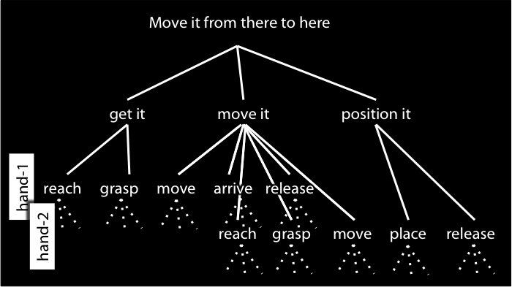
Do that
=
?
Notes:
But we can’t point to motor representations like we can point to maps!
What we need for reference by deference to a motor representation is experience of motor action.
And if you think about motor imagination it seems quite plausible that we do have such experiences.
So here’s the thought:
There are no direct inferential connections between intentions and motor representations.
Harmony is ensured by the fact that where an intention involves a bodily movement, either executing that intention involves forming a further intention or else the intention involves a demonstrative that refers to an action by deferring to a motor representation.
So what connects intentions to motor representations---what connects the reflective to the pre-reflective---is the use of demonstratives, and this depends on experience of motor action.
Much as on some views all thought about objects ultimately depends on perceptual experience (e.g. Campbell 2002), so also intending bodily actions may ultimately depend on motor experience.
Experience anchors the reflective in the pre-reflective.

Slide 77
The Interface Problem:
How are non-accidental matches possible?
Reciprocal agent-neutral motor representations:
i. represent outcomes;
ii. ground the purposiveness of some
joint actions; and
iii. differ in format from (the constituent attitudes of) shared intentions.
Two outcomes, A and B, match in a particular context just if, in that context, either the occurrence of A would normally constitute or cause, at least partially, the occurrence of B or vice versa.
Some joint actions involve both shared intention and reciprocal agent-neutral motor representation
Notes:
This might work for the individual case. But does it also work for the joint case?

Slide 78
The Interface Problem:
How are non-accidental matches possible?
Reciprocal agent-neutral motor representations:
i. represent outcomes;
ii. ground the purposiveness of some
joint actions; and
iii. differ in format from (the constituent attitudes of) shared intentions.
Two outcomes, A and B, match in a particular context just if, in that context, either the occurrence of A would normally constitute or cause, at least partially, the occurrence of B or vice versa.
Some joint actions involve both shared intention and reciprocal agent-neutral motor representation
Notes:
Formally I think there’s no problem at all with the idea that shared intentions involve demonstrative reference to actions by deferring to component representations of social motor representations.
But for this to work, the component representations of social motor representations and the actions they cause have to be experienced in some way.
I’m not at all sure if this is right; to be honest I’ve only just started thinking about it.
But it is an intriguing idea that there we can experience actions which are not entirely our own, and it might just be true that these experiences, by enabling demonstrative reference, are what connect shared intentions with social motor representations.
Here’s the beautiful thing.
Social motor representations are just structures of ordinary motor representations.
There’s no social magic here, no mystical ingredient needed to glue joint actions together.
If we suppose, similarly, that shared intentions are structures of ordinary intentions and knowledge states
then it seems to me that the solving the interface problem for the individual case already provides a solution to the joint case as well.
So recognizing social motor representations as grounding the purposiveness of some joint actions does create an interface problem; but as far as I can tell, it doesn’t create a problem distinct from the problem that we already have by recognizing that motor representations ground the purposiveness of actions more generally.
There is a problem here, I think, but it isn’t specifically about either joint or individual action.

Slide 79
The Interface Problem:
How are non-accidental matches possible?
Reciprocal agent-neutral motor representations:
i. represent outcomes;
ii. ground the purposiveness of some
joint actions; and
iii. differ in format from (the constituent attitudes of) shared intentions.
Two outcomes, A and B, match in a particular context just if, in that context, either the occurrence of A would normally constitute or cause, at least partially, the occurrence of B or vice versa.
Some joint actions involve both shared intention and reciprocal agent-neutral motor representation
Notes:
in conclusion ...
I’ve developed two ideas.
The first is that it’s a mistake to think we can fully explain what joint action is by appeal to shared intention only.
If it’s true that social motor representation enables some joint actions, then social motor representation plays a distinctive role in grounding the purposiveness of joint action.
So fully explicating joint action involves appeal to both pre-reflective and reflective structures, structures of motor representation as well as to structures of intention.
The second idea is really just a challenge.
Some joint actions involve both shared intention and social motor representation
and there is a question about how these two can ever non-accidentally harmoniously contribute to a single joint action rather than always pulling in different directions.
This question is a problem because the obvious answer---appeal to a process of planning---is blocked by the fact that shared intention and social motor representation involve different representational formats.
My very tentative suggest here was that some shared intentions may be anchored in social motor representations by means of demonstrative elements which refer to joint actions by deferring to components of social motor representations.
If that is right, experience of action has a key role to play in linking reflective and pre-reflective states and processes in joint action.

